Slide 1
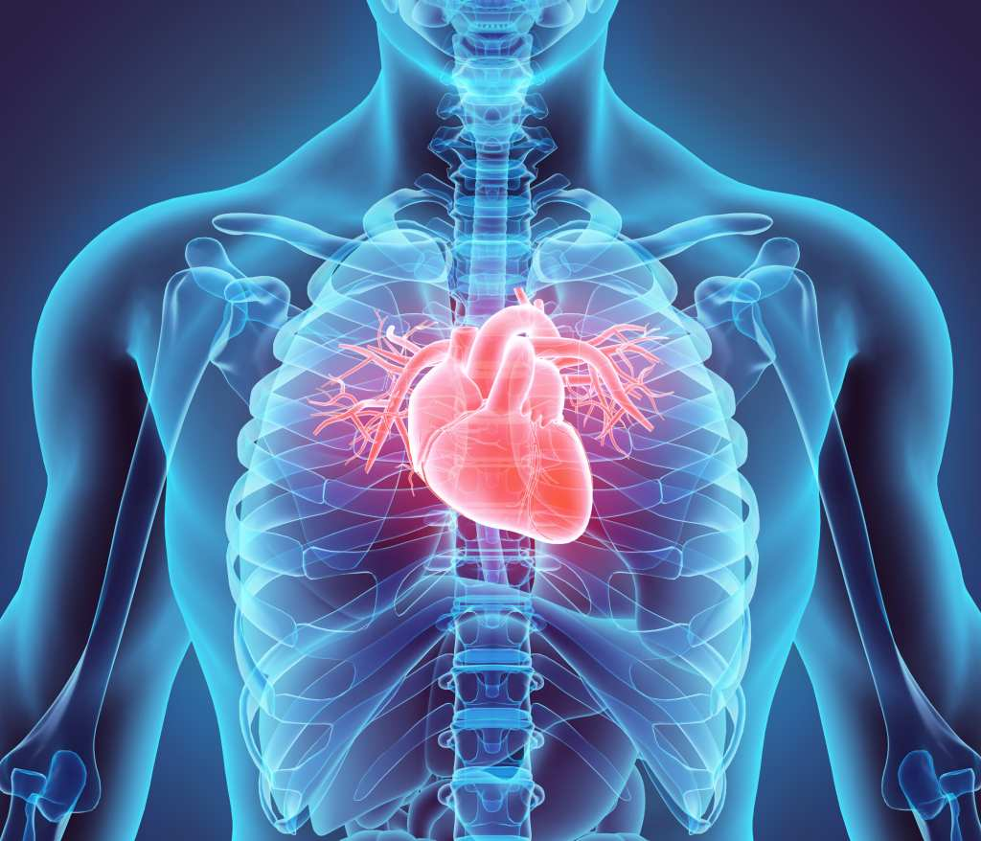
Our Body Shira- Shahar- Salome

Slide 2
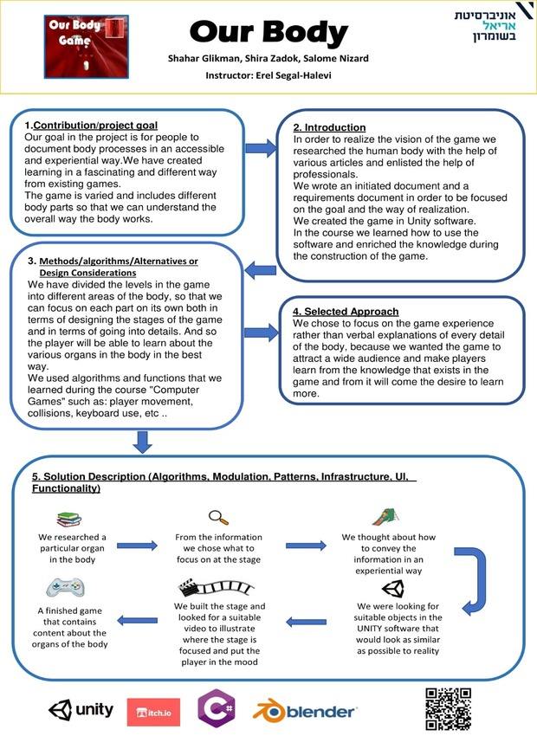

Slide 3
Our goal
Our goal in the project is for people to document body processes in an accessible and experiential way. We have created learning in a fascinating and different way from existing games.
The game is varied and includes different body parts so that we can understand the overall way the body works.

Slide 4

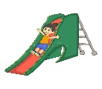

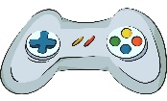


Our process:
We researched a particular organ in the body
From the information we chose what to focus on at the stage
We thought about how to convey the information in an experiential way
A finished game that contains content about the organs of the body
We built the stage and looked for a suitable video to illustrate where the stage is focused and put the player in the mood
We were looking for suitable objects in the UNITY software that would look as similar as possible to reality

Slide 5
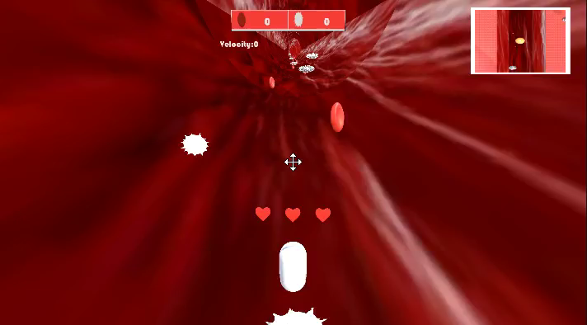
Level 1 - Corona

Slide 6
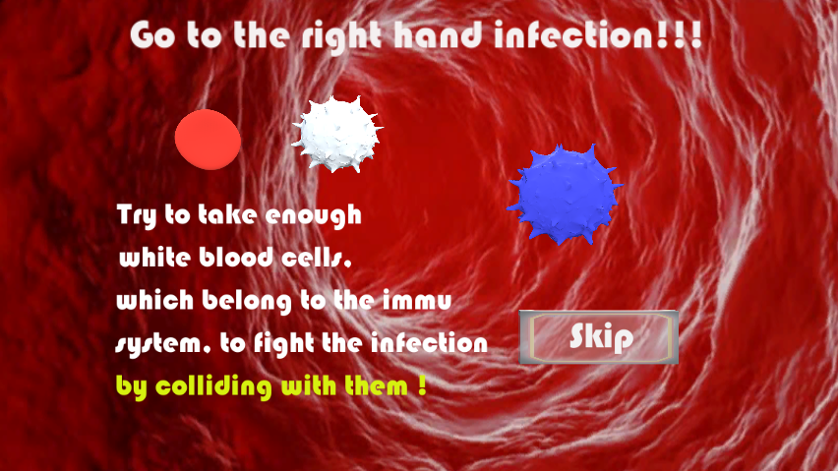
Level 2 - Legs

Slide 7
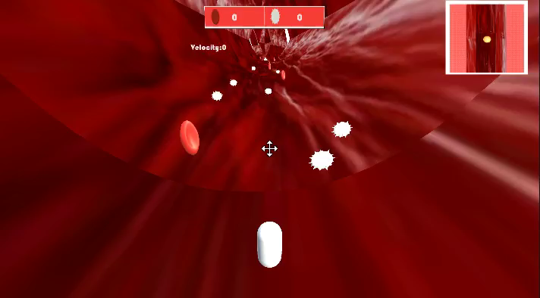
Level 2 - Legs

Slide 8
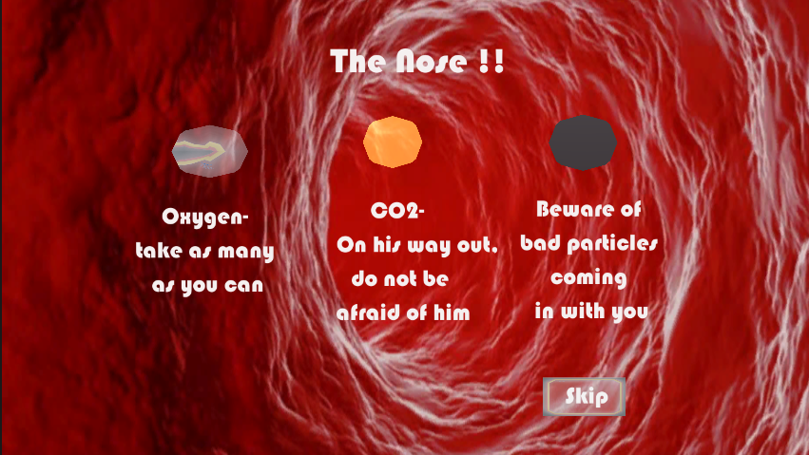
Level 3 - Nose

Slide 9
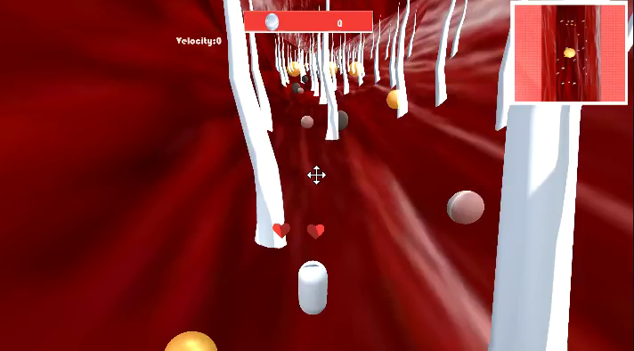
Level 3 - Nose

Slide 10
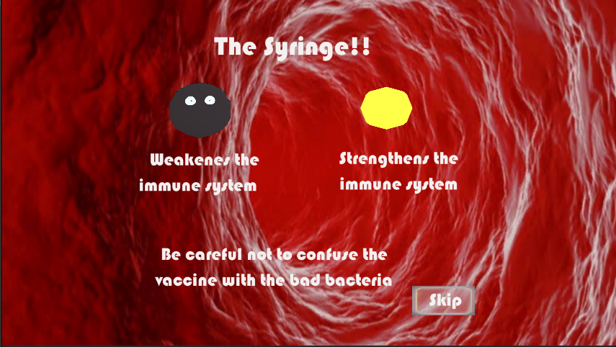
Level 4 – Vaccine

Slide 11
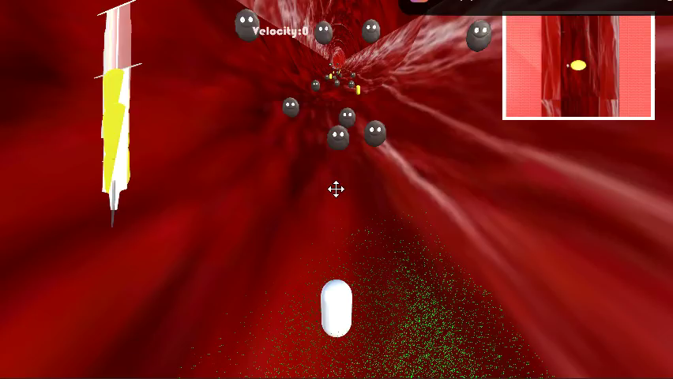
Level 4 – Vaccine

Slide 12
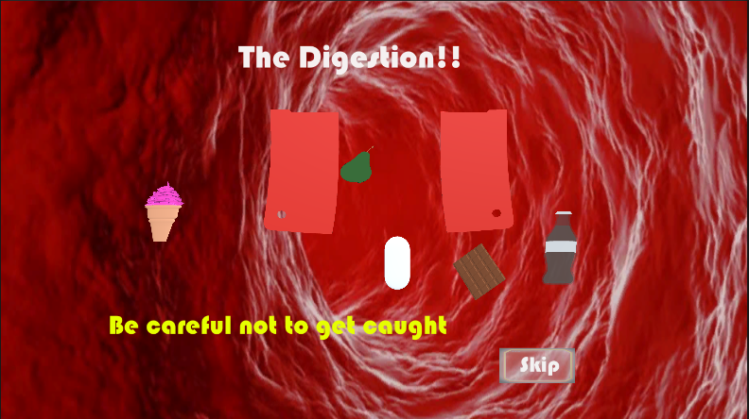
Level 5 - Stomach

Slide 13
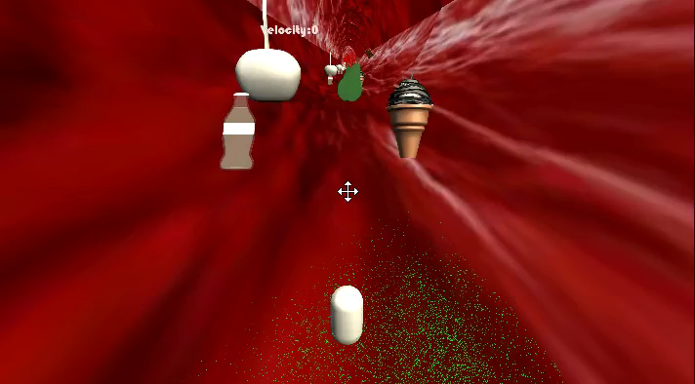
Level 5 - Stomach

Slide 14
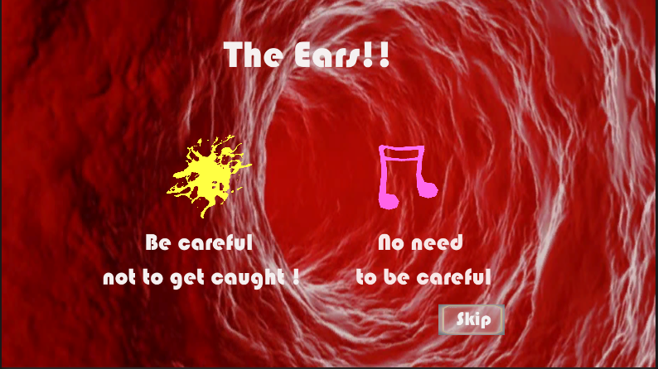
Level 6 - Ears

Slide 15
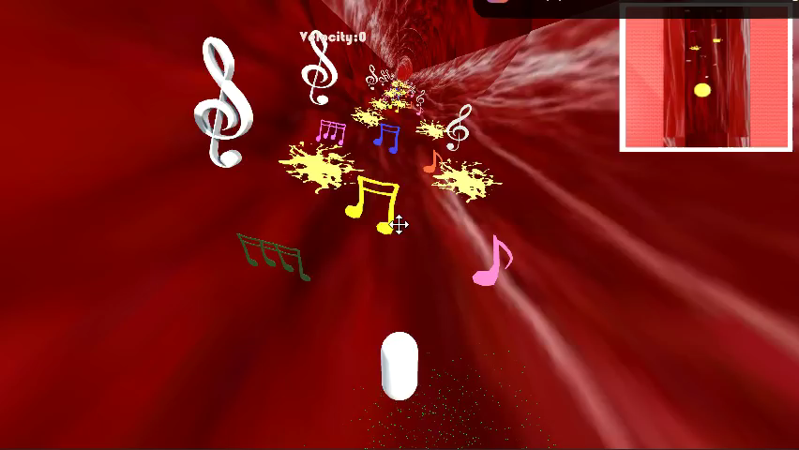
Level 6 - Ears

Slide 16
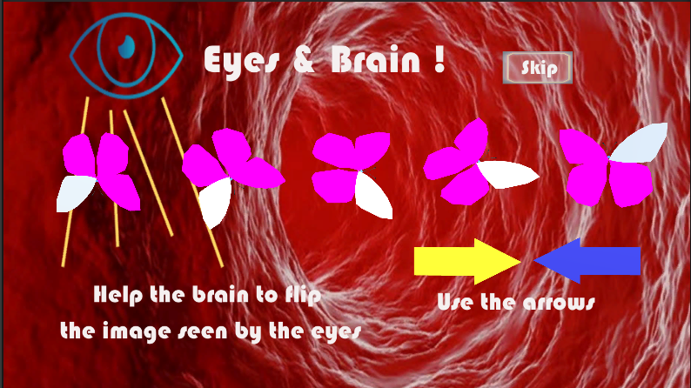
Level 7 – Eyes & Brain

Slide 17
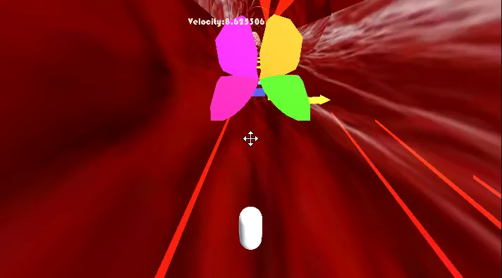
Level 7 – Eyes & Brain

Slide 18
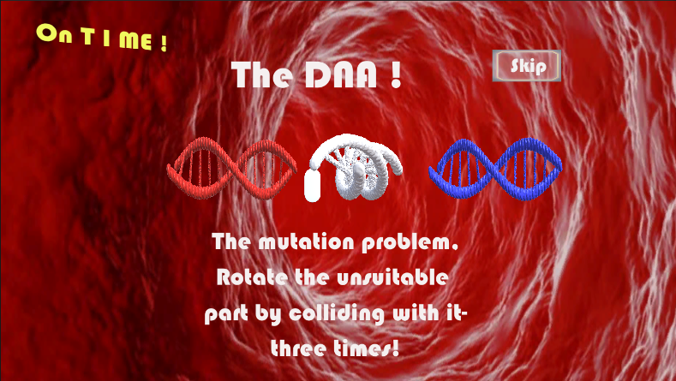
Level 8 – DNA

Slide 19
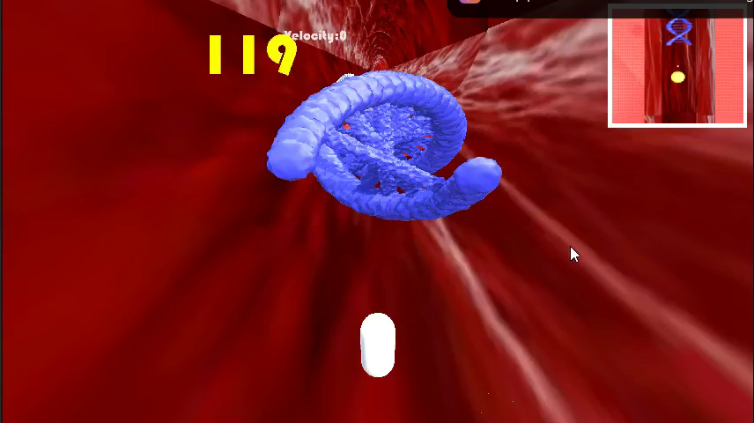
Level 8 – DNA

Slide 20
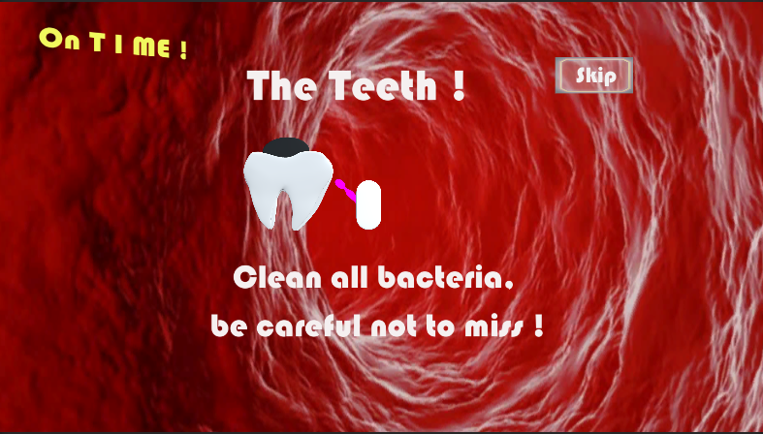
Level 9 – The teeth

Slide 21
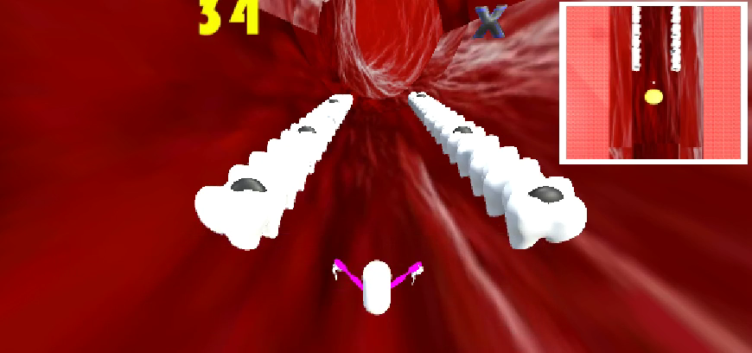
Level 9 – The teeth

Slide 22
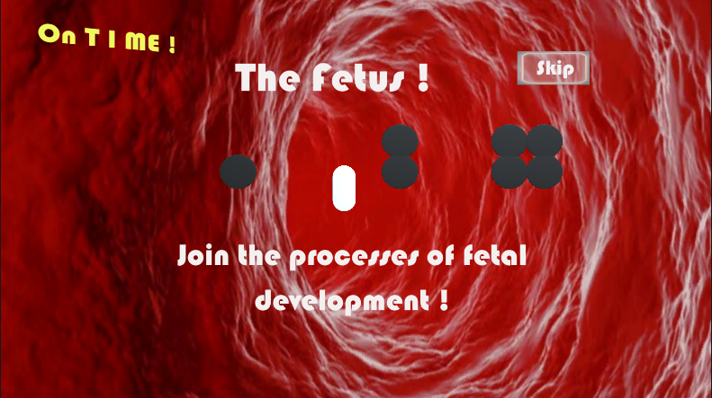
Level 10 – The fetch

Slide 23
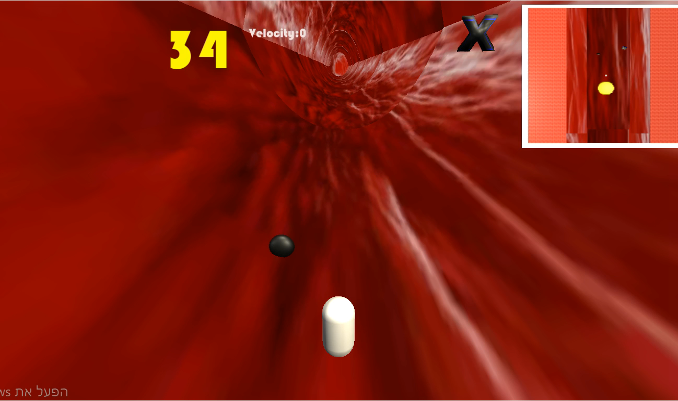
Level 10 – The fetch

Slide 24
The End

